Slide 1

Predicting Flight Delays with Error Calculation using Machine Learned Classifiers
18BD1A05A3
18BD1A05AA
18BD1A05AG
18BD1A05B9
CSE-F

Slide 2
Outline
Abstract
Introduction
Problem Statement
Existing System and Proposed System
Software Requirements
Hardware Requirements
Literature Survey
Implementation
Test Cases
References

Slide 3
Abstract
Flight delay is a major problem in the aviation sector. During the last two decades, the growth of the aviation sector has caused air traffic congestion, which has caused flight delays.
Flight delays result not only in the loss of fortune also negatively impact the environment. They also cause significant losses for airlines operating commercial flights.
Therefore, they do everything possible in the prevention or avoidance of delays and cancellations of flights by taking some measures.
Using machine learning models such as Logistic Regression, Decision Tree Regression, Random Forest Regression we predict whether the arrival of a particular flight will be delayed or not.

Slide 4

Introduction
The aviation industry around the globe incur huge losses due to various factors, one of these factors is Airline Delay. Airline delay tends to be onerous for every entity involved i.e. airports, airlines and passengers.
As per the numbers from Bureau of Transportation Statistics (BTS) approximately 20% of all the commercial flights are delayed. These delays are responsible for large economic and environmental losses.

Slide 5
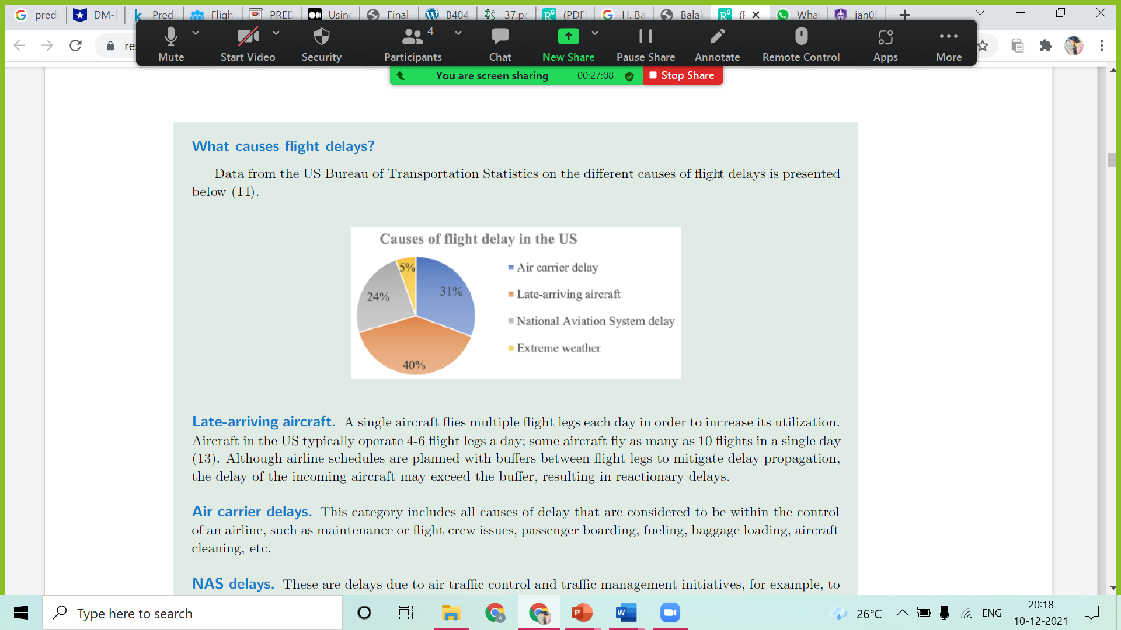
Problem Statement
Late-arriving aircraft
Air carrier delays
NAS delays
Extreme weather

Slide 6
Existing System
Proposed System
There have been too many studies in this area. For example, older Regression method has been used to compute delay propagation.
For this model, the destination delay is highly dependent to arrival flights and the effective factors include; day, time, airport capacity and some factors are related to passenger loads.
We develop a system that predicts for a delay in flight departure based on certain parameters.
We train our model for forecasting using various attributes of a particular flight, such as arrival performances, flight summaries, origin/destination, etc.

Slide 7


SOFTWARE REQUIREMENTS
Programming Language:
Python
IDE:
Jupyter

Slide 8



HARDWARE REQUIREMENTS
Processor:
Ram:
Hard Disk:
I3
4GB
500GB

Slide 9
LITERATURE SURVEY
Shao, Wei.
"Flight Delay Prediction using Airport Situational Awareness Map."
2. Raj, Jennifer S., and J. Vijitha Ananthi.
"Recurrent neural networks and nonlinear prediction in support vector machines."
Wei shao and eight others worked on this paper for predicting flight delays with help of the airport situational awareness map.
They mainly used a Data-driven framework where it is suitable for prediction of departure flight delays and also explored other different features that are taken from the awareness map.
Dr. Jennifer S. Raj and J. Vijitha Ananthi proposed to use an SVM optimized approach to RNN for solving nonlinear regression estimation.
This model improved the speed and accuracy in identifying optimal values of the SVM parameters.

Slide 10
LITERATURE SURVEY
3. Ye, Bojia.
"A Methodology for Predicting Aggregate Flight Departure Delays in Airports Based on Supervised Learning."
4. Musaddi , Roshni.
"Flight Delay Prediction using Binary Classification."
Predicting delay among flights using Supervised Learning model built by with local weather characteristics, Airport related aggregate, time, flight-plan and delay.
This paper proposes Binary Classification for predicting delay in flight take offs.
We have taken datasets of different airlines from different airports to check which one gets delayed more often.
The delay can be due to climate conditions or traffic in airspace and airports or any other reason.

Slide 11
LITERATURE SURVEY
5. Khanmohammadi, Sina, Salih Tutun, and Yunus Kucuk .
"A new multilevel input layer artificial neural network for predicting flight delays at JFK airport."
6. Ding, Yi.
"Predicting flight delay based on multiple linear regression."
A new ANN structure (DMP-ANN) is introduced which is suitable for prediction of defects such as delays in operations.
This structure is appropriate for problems with nominal variables, where traditional ANN models have difficulties.
This paper considered the problem of predicting flight arrival delay and presented a prediction results.
The problem was treated as both a regression and an ordinal classification task and a suitable approach, based on the multiple linear regression model, was used to predict the delay.

Slide 12
LITERATURE SURVEY
7. Kalliguddi, Anish M., and Aera K. Leboulluec.
"Predictive modeling of aircraft flight delay."
8. “Airline Delay Prediction using Machine Learning Techniques. “
Devansh Shah, Ayushi Lodaria, Danish Jain, Lynette D’Mello
This study is devoted to develop a predictive model to forecast flight delays.
Models based on multiple linear regression, decision trees and random forest algorithms are created and tested in R-studio software concluding that Random forest model outperforms other two models based on the evaluation criteria.
This study shows that machine learning algorithms can be efficaciously used to predict flight delays.
The purpose of doing the above classification and analysis, is to gauge the delay not only to suffice the various purposes of mankind, but also analyze factors affecting delay such as „WeatherDelay‟, „NASDelay‟.

Slide 13

IMPLEMENTATION
Home page

Slide 14
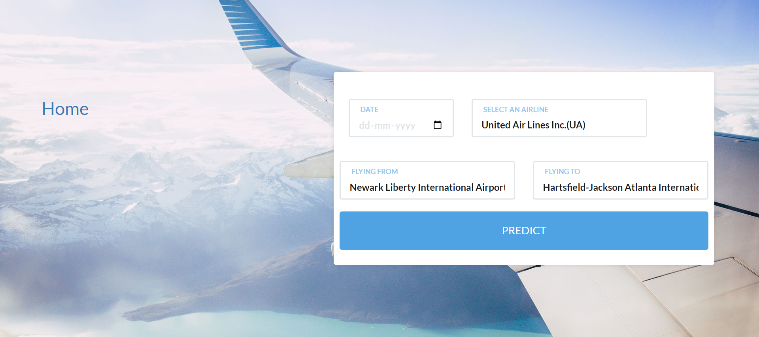
IMPLEMENTATION
Prediction for Customers

Slide 15
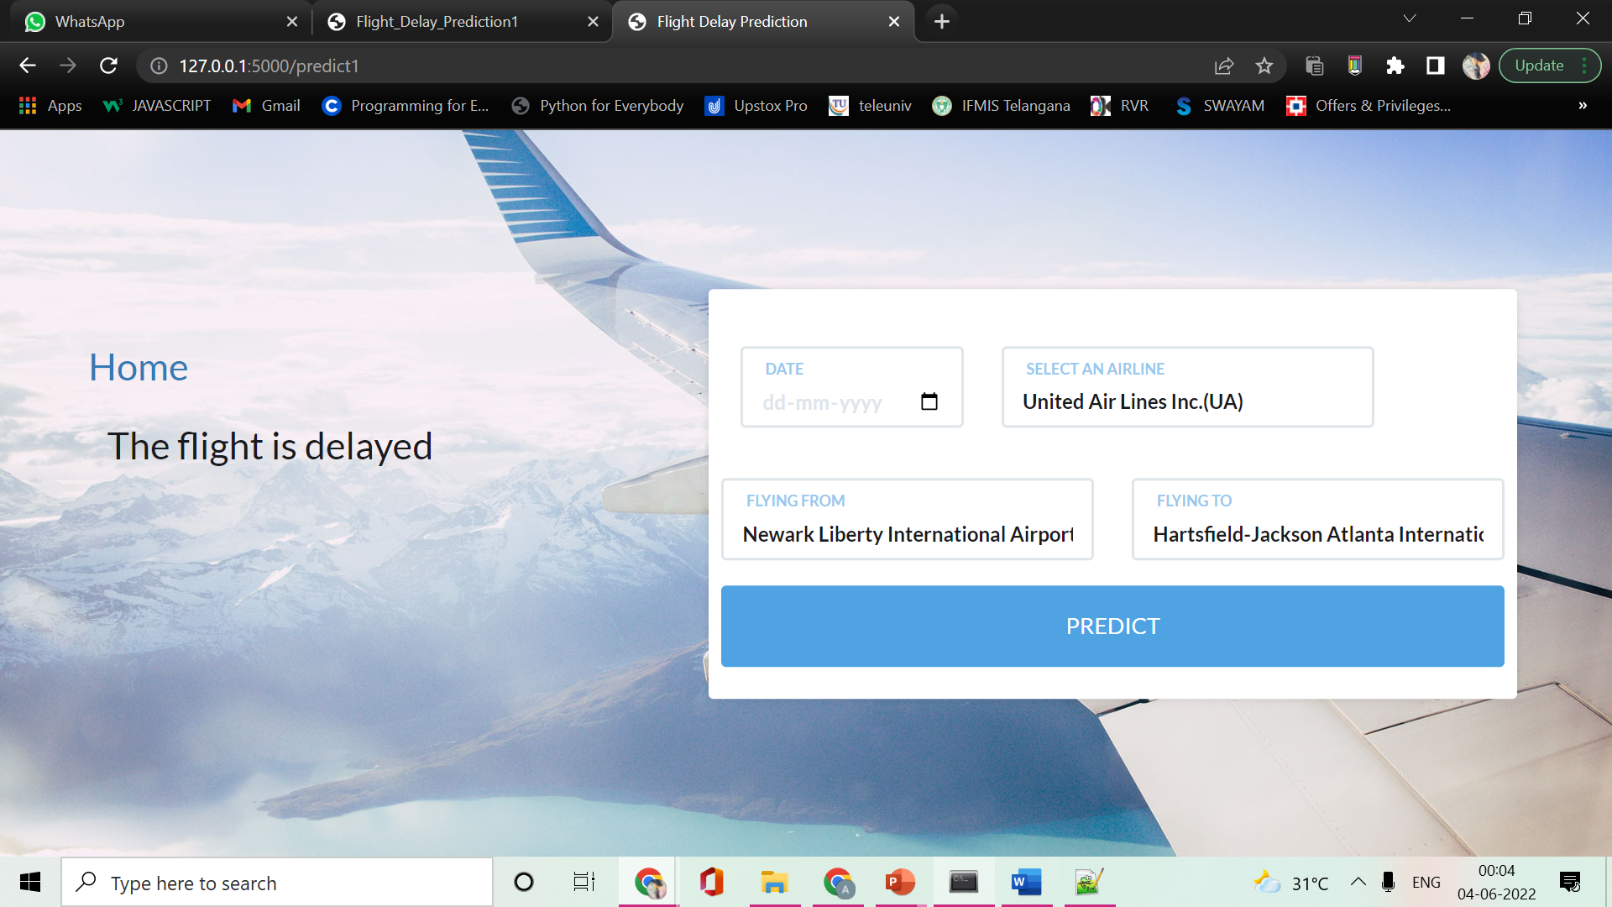
IMPLEMENTATION
Prediction for Customers- Delayed

Slide 16
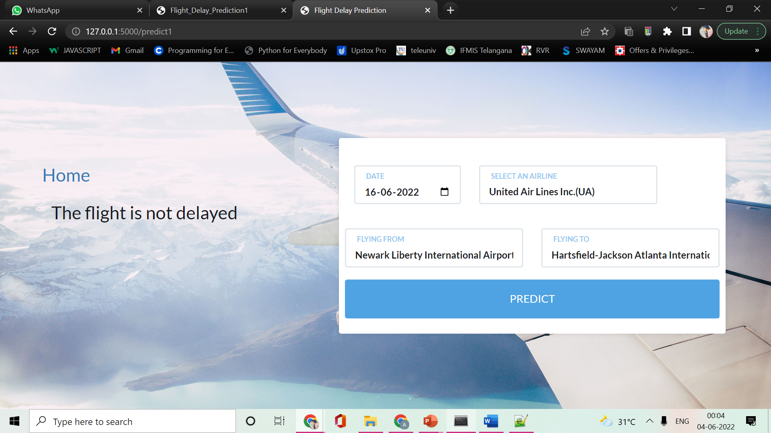
IMPLEMENTATION
Prediction for Customers- Not delayed

Slide 17
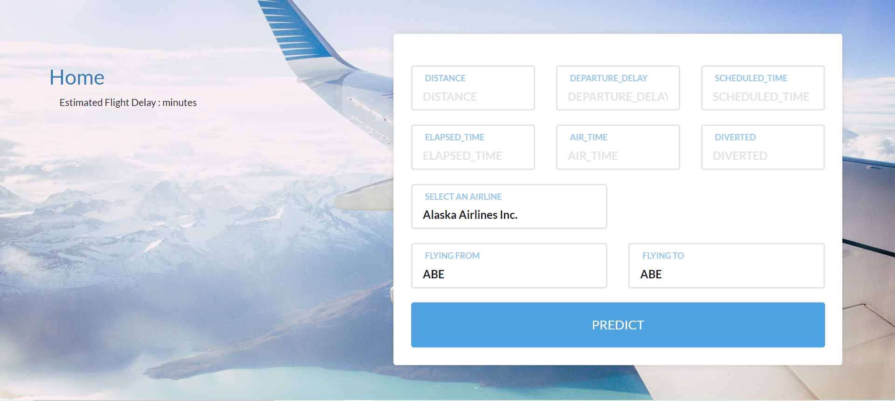
IMPLEMENTATION
Prediction for Authorities

Slide 18
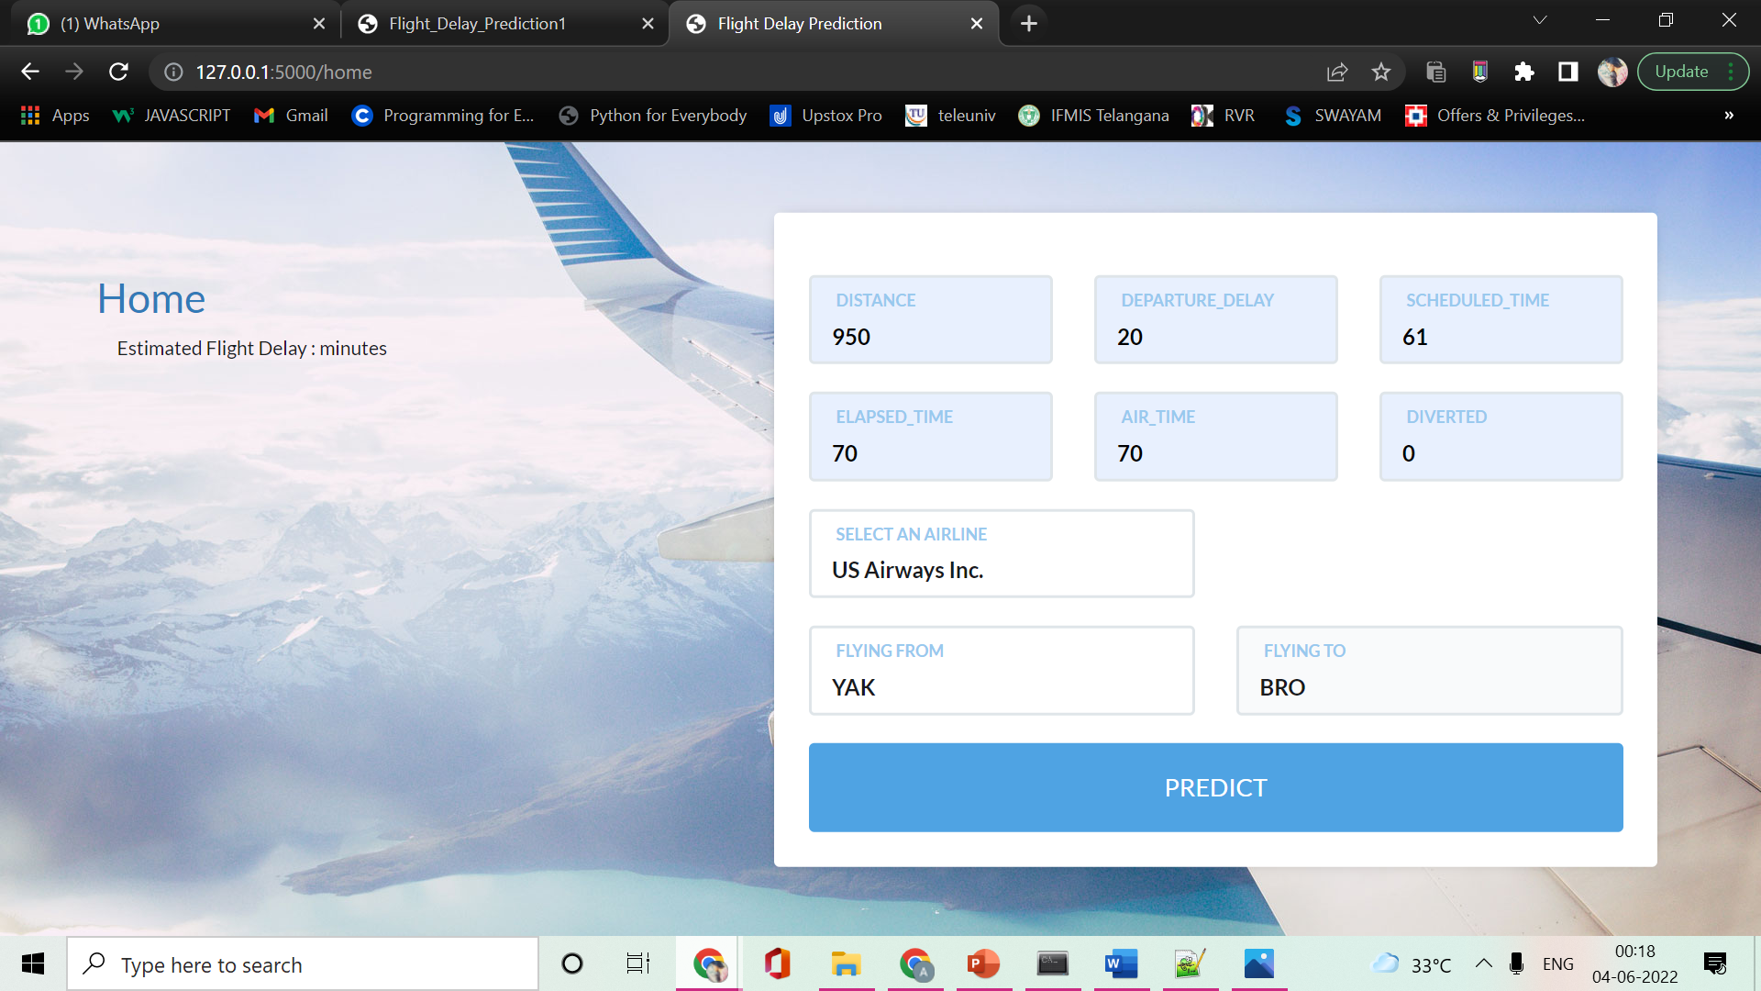
IMPLEMENTATION
Prediction for Authorities - Data

Slide 19

IMPLEMENTATION
Prediction for Authorities – Estimated delay

Slide 20
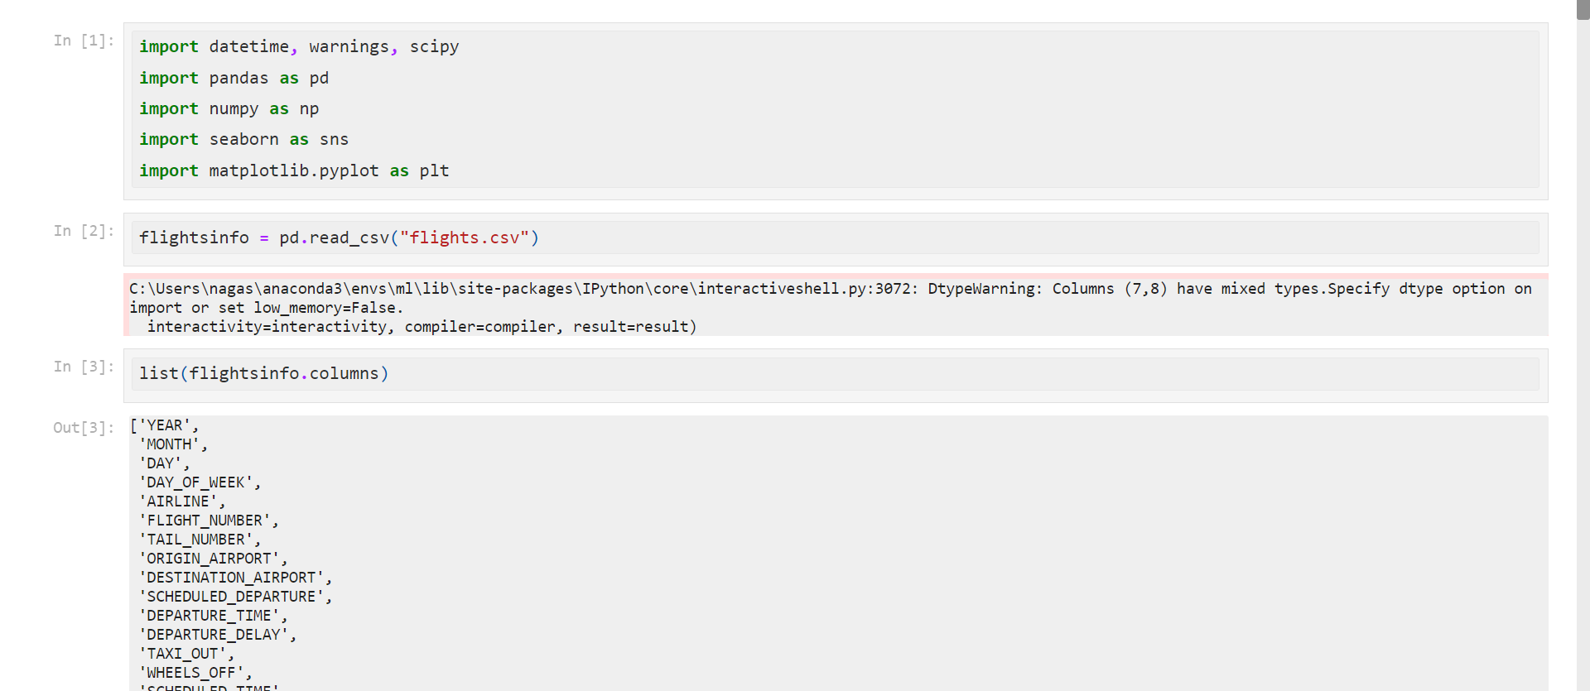
TEST CASES
Load Dataset

Slide 21
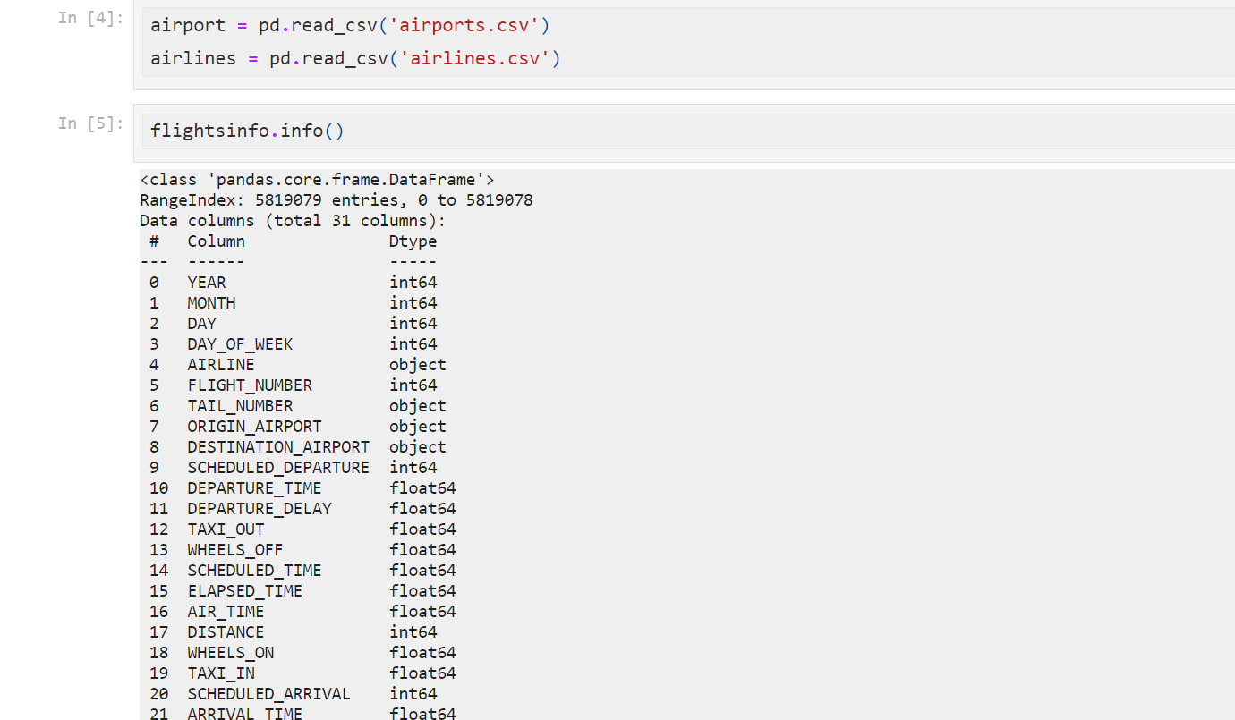
TEST CASES
Load dataset

Slide 22
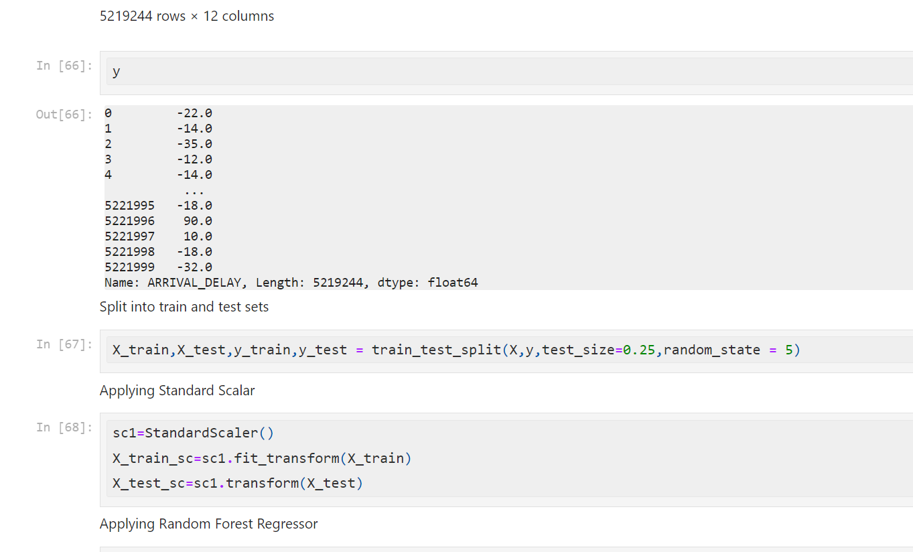
TEST CASES
Split dataset

Slide 23
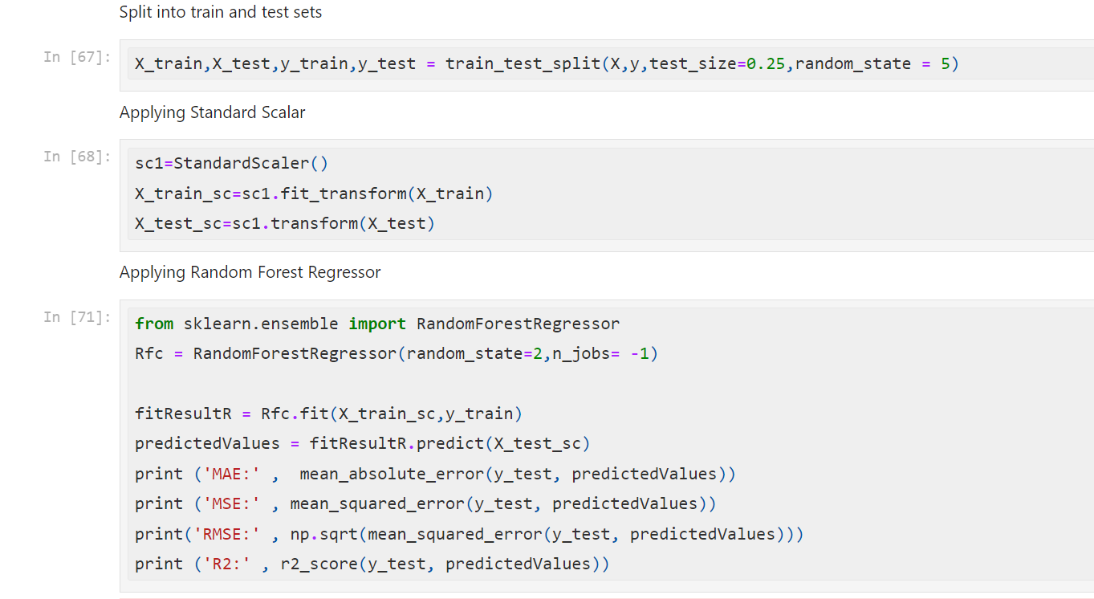
TEST CASES
Train model

Slide 24
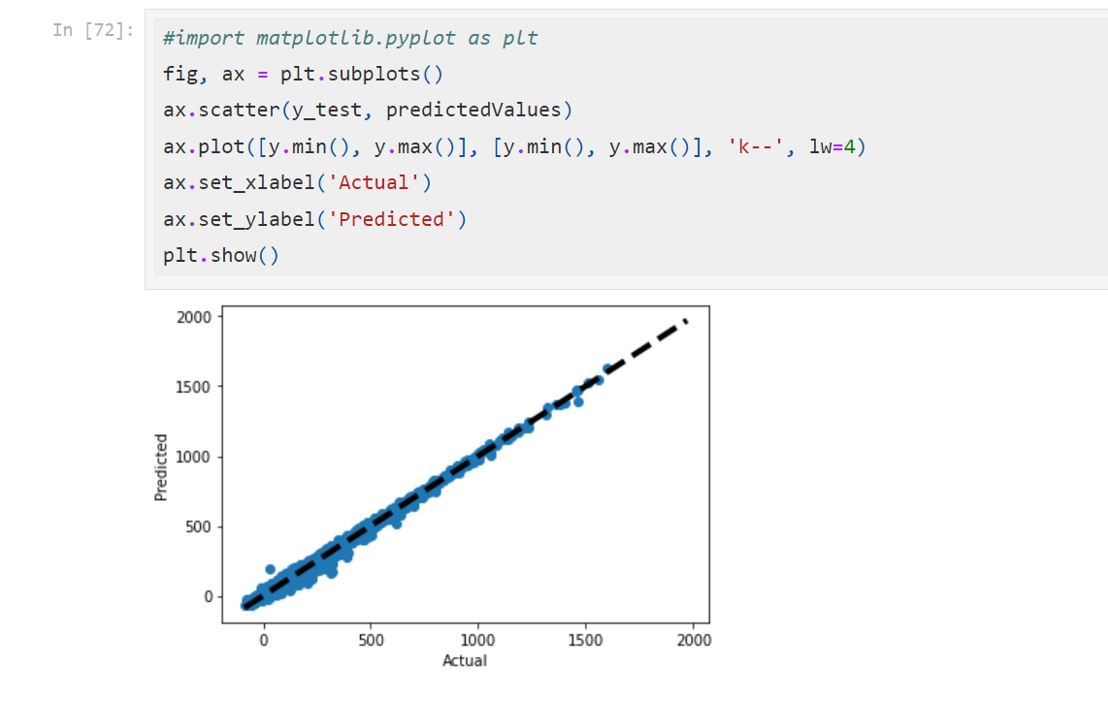
TEST CASES
Validate model

Slide 25
TEST CASES
Predictions
Delayed
Not delayed

Slide 26
TEST CASES
Predictions
Data
Estimated flight delay time

Slide 27
REFERENCES
Shao, Wei, et al. "Flight Delay Prediction using Airport Situational Awareness Map." Proceedings of the 27th ACM SIGSPATIAL International Conference on Advances in Geographic Information Systems. 2019.
Raj, Jennifer S., and J. Vijitha Ananthi. "Recurrent neural networks and nonlinear prediction in support vector machines." Journal of Soft Computing Paradigm (JSCP) 1.01 (2019): 33-40.
Ye, Bojia , et al. "A Methodology for Predicting Aggregate Flight Departure Delays in Airports Based on Supervised Learning." Sustainability 12.7 (2020): 2749.
Musaddi , Roshni, et al. "Flight Delay Prediction using Binary Classification."

Slide 28
REFERENCES
Khanmohammadi , Sina , Salih Tutun , and Yunus Kucuk . "A new multilevel input layer artificial neural network for predicting flight delays at JFK airport." Procedia Computer Science 95 (2016): 237-244.
Ding, Yi. "Predicting flight delay based on multiple linear regression." IOP Conference Series: Earth and Environmental Science. Vol. 81.No. 1.IOP Publishing, 2017.
Kalliguddi , Anish M., and Aera K. Leboulluec . "Predictive modeling of aircraft flight delay." Universal Journal of Management 5.10 (2017): 485-491.
Airline Delay Prediction using Machine Learning Techniques. Devansh Shah, Ayushi Lodaria , Danish Jain, Lynette D’Mello . ISSN: 2277-3878, Volume-9 Issue-2, July 2020.

Slide 29

Thank you

